Slide 1
HTTP and Web Application
<number>/41

Slide 2
Objectives
HTTP protocol
  Request – reponse model
  Request
  Response
  Status code
HTML
  Web page structure
  Form tag
Web Application model
  Web browser
  Web Server
<number>/41

Slide 3
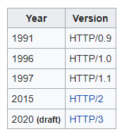
HTTP protocol
HTTP is the foundation of data communication for the World Wide Web
  Development of HTTP was initiated by Tim Berners-Lee at CERN in 1989.
  request–response protocol in the client–server computing model
  State-less protocol
  Not session-less
  HTTP resources are identified
  and located on the network by
  Uniform Resource Locators (URL)
<number>/41

Slide 4
HTTP Requests
An HTTP request consists of
  a request method
  a request URL
  header fields
  body.
HTTP 1.1 defines the following request methods:
  GET - retrieves the resource identified by the request URL.
  HEAD - returns the headers identified by the request URL.
  POST - sends data of unlimited length to the web server.
  PUT - stores a resource under the request URL.
  DELETE - removes the resource identified by the request URL.
  OPTIONS - returns the HTTP methods the server supports.
  TRACE - returns the header fields sent with the TRACE request.
<number>/41

Slide 5
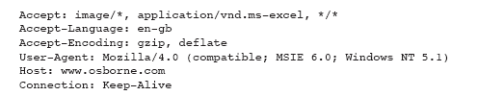
HTTP Request Sample
<number>/41

Slide 6
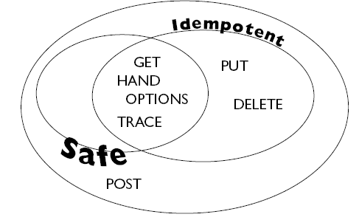
Idempotency and Safety Methods
<number>/41
Notes:
Idempotent: An idempotent request is meant to have the same result no
matter how many times it is executed.

Slide 7
HTTP Responses
An HTTP response contains
  a result code
  header fields
  a body
The HTTP protocol expects the result code and all header fields to be returned before any body content
Some commonly used status codes include:
  404 - indicates that the requested resource is not available.
  401 - indicates that the request requires HTTP authentication.
  500 - indicates an error inside the HTTP server which prevented it from fulfilling the request.
  503 - indicates that the HTTP server is temporarily overloaded, and unable to handle the request.
<number>/41

Slide 8
HTTP 1.1 Status Codes
Switching Protocols
Server will comply with Upgrade header and change to different protocol. (New in HTTP 1.1)
OK
Everything's fine; document follows for GET and POST requests. This is the default for servlets; if you don't use setStatus, you'll get this.
Created
Server created a document; the Location header indicates its URL.
202 Accepted
Request is being acted upon, but processing is not completed.
203 Non-Authoritative Information
Document is being returned normally, but some of the response headers might be incorrect since a document copy is being used.
<number>/41

Slide 9
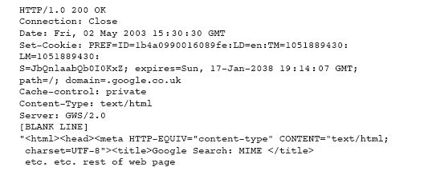
HTTP Response Sample
<number>/41

Slide 10
Request Headers
It can also send a number of headers:
  Accept The MIME types the browser prefers.
  Accept-Charset The character set the browser expects.
  Content-Length (for POST messages, how much data is attached)
  Connection Use persistent connection? If a servlet gets a Keep-Alive.
  Cookie (one of the most important headers)
  Host (host and port as listed in the original URL)
  If-Modified-Since (only return documents newer than this)
  Referer (the URL of the page containing the link the user followed to get to current page)
<number>/41

Slide 11
HTTP Response
When a Web server responds to a request from Web client, the response typically consists of a status line, some response headers, a blank line, and the document:
    HTTP/1.1 200 OK status line
    Content-Type: text/plain response header
  blank line
  Welcome to Servlets World the document
  Status line:
  HTTP version
  An integer that is interpreted as a status code
  A very short message corresponding to the status code.
  In most cases, all of the headers are optional except for Content-Type, which specifies the MIME type of the document that follows
<number>/41

Slide 12
What is HTML?
HTML is a language for describing web pages.
HTML stands for Hyper Text Markup Language
HTML is not a programming language, it is a markup language
A markup language is a set of markup tags
HTML uses markup tags to describe web pages
<number>/41

Slide 13
HTML Documents = Web Pages
HTML documents describe web pages
HTML documents contain HTML tags and plain text
HTML documents are also called web pages
<number>/41

Slide 14
HTML Tags
HTML markup tags are usually called HTML tags
HTML tags are keywords surrounded by angle brackets like <html>
HTML tags normally come in pairs like <b> and </b>
The first tag in a pair is the start tag, the second tag is the end tag
Start and end tags are also called opening tags and closing tags.
<number>/41

Slide 15
HTML Form
A form is an area that can contain form elements.
Form elements are elements that allow the user to enter information (like text fields, textarea fields, drop-down menus, radio buttons, checkboxes, etc.) in a form.
<number>/41

Slide 16

HTML Form Inputs
Text fileds
<html>
<body>
<form>
First name: <input type="text" name="firstname" />
<br />
Last name: <input type="text" name="lastname" />
</form>
</body>
<html>
How it looks in a browser:
<number>/41

Slide 17

HTML Form Inputs..
Radio Buttons:
<html>
<body>
<form>
<input type="radio" name="sex" value="male" /> Male
<br />
<input type="radio" name="sex" value="female" /> Female
</form>
</body>
<html>
How it looks in a browser:
<number>/41

Slide 18
The Form's Action Attribute and the Submit Button
When the user clicks on the "Submit" button, the content of the form is sent to the server. The form's action attribute defines the name of the file to send the content to. The file defined in the action attribute usually does something with the received input.
<number>/41

Slide 19
The Form's Action Attribute and the Submit Button
<html>
<body>
<form name="input" action="/LoginServlet" method="post">
<table>
<tr>
<td>User name:</td><td><input type="text" name="user"/></td>
</tr>
<tr>
<td>Password:</td><td><input type="password" name="pass"/></td>
</tr>
<tr>
<td></td><td><input type="submit" value="Login"/></td>
</tr>
</table>
</form>
</body>
<html>
<number>/41

Slide 20
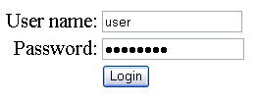
The Form's Action Attribute and the Submit Button
<number>/41

Slide 21
Web page example
<html>
<body>
<h1>My First Heading</h1>
<p>My first paragraph</p>
<a href=“http:\\cms.fpt.edu.vn”>Studying place</a> </body>
</html>
<number>/41

Slide 22
Web application
A web application or webapp is an application that is accessed via web browser over a network such as the Internet or an intranet.
It is also a computer software application that is coded in a browser-supported language (such as HTML, JavaScript, Java, etc.) and reliant on a common web browser to render the application executable.
Web applications are popular due to the ubiquity of web browsers, and the convenience of using a web browser as a client, sometimes called a thin client.
<number>/41

Slide 23
Web browser
The purpose of a web browser (like Internet Explorer or Firefox) is to read HTML documents and display them as web pages.
The frontend of a web application is created using the scripting languages such as HTML, CSS, and JavaScript, supported by almost all web browsers
The browser does not display the HTML tags, but uses the tags to interpret the content of the page
<number>/41

Slide 24
Web server
A web application is deployed on a web server
Web server is a process that handles the client's request and responds.
It processes the request made by the client by using the related protocols.
The main function of the webserver is to store the request and respond to them with web pages.
The backend is created by any of the programming languages such as Java, Python, Php, etc.. and databases
<number>/41

Slide 25
Summary
HTTP protocol
Request – reponse model
Request methods
Request – response header
HTTP status code
HTML Introduction
What is HTML?
HTML Tags
HTML Documents = Web Pages
HTML form
Example
Web application
Web browser
Web server
<number>/41

Slide 26
Constructivity question
When a user login into a website, what actions are taking place behind the scenes? Describe this process and show how the actors interact.
  How many client-server interactions are there in the login task?
  Why can we use different browsers to login?
  What are the outstanding features of the HTTP protocol that should be noted?
  What other protocols are there for the web model besides HTTP?
  How many ways to talk between client and web-server in HTTP
  How is the error occurring during the login process represented and handled?
<number>/41

